Slide 1

LoRA is all YOU need
Notes:
In 2017 some researchers in google published a paper where they made a very strong statement : attention is all you need. In thi paper they introduced the transformer architecture that was then the base for all the most recent ai models, from gpt to llama to gemini. Now, for sure this architecture wass all google, microsoft and open ai, that are the companies whio trained all thise models needed.

Slide 2
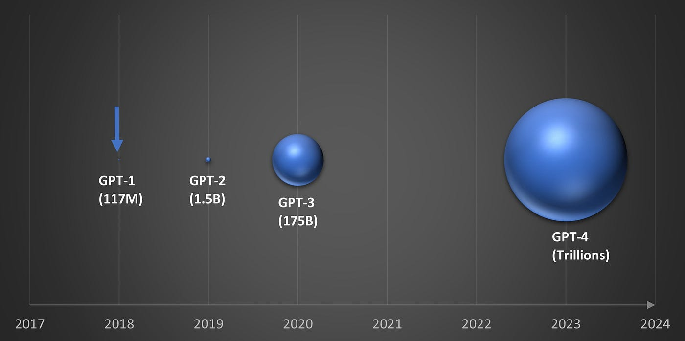
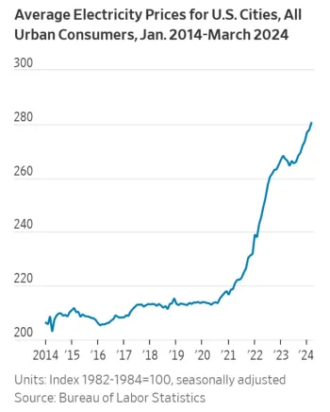
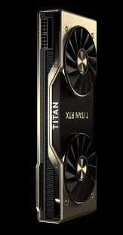
Training a transformer
Exponential growth in model parameters
Training time and hardware requirements
Energy consumption and sustainability
Extremely high costs and entrance barriers
Data requirements
Notes:
Now, this is because the companies I quoted before, are training bigger and bigger models with the numbre of parameters increasing exponentially. You can see that GPT1… to GPT4.
And the more they increase the parameters the arder it will be to train models with comparable performances.
Now lets imagine that you are a developer or an entrepeneur and need an llm to solve a specific task. The if this task is very specific, you the pretrained model will not perform bery well.
Then you can try to train you own model.
Thwn you would need a gpu. Let s say that you have a very powerful one, like ths one. And you don’t have one, you have a device with 100 od them. And you don’t have only one of these devices, you have 1000 of them and you let the work all together to train the model. Then you would need more than a month to finish the trainng. Imagine if you try to do the same on a way less powerful hardware such as the one that the majority of the companies or developers have.

Slide 3


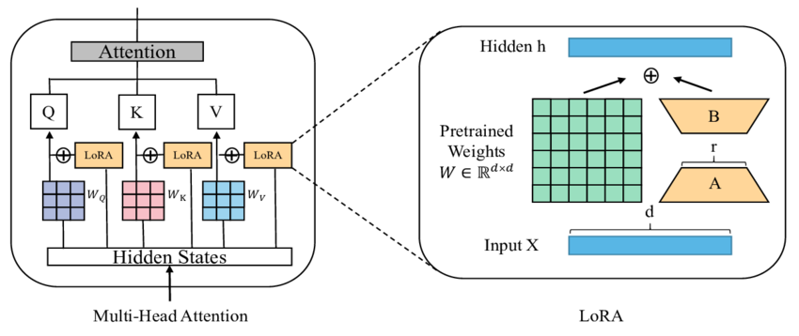
Lora
(Low Rank Adaptation)

Slide 4
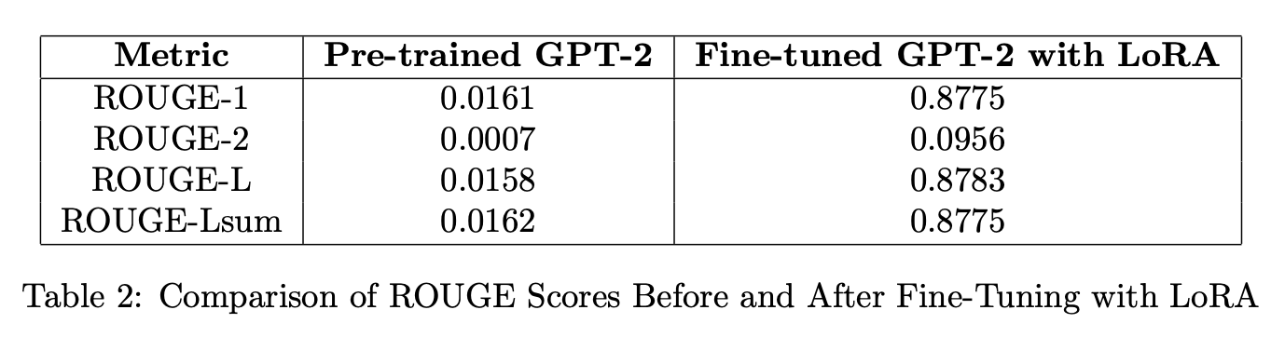
THE POWER OF LoRA
ONLY
OUR TASK
Identifying wether 2 sentences have the same meaning
1 % OF THE PARAMETERS UPDATED
15 MINUTES OF TRAINING
+ 5350%
PERFORMANCE IMPROVEMENT

Slide 5
LoRA and AI DEMOCRATIZATION
Reduced Computational Complexity and resources needed
Lower Costs and Energy Consumption
High performances
Flexible
Requires minimal data
Sustainable
Perfect for
Low resources NLP tasks
Startups
Hospitals or public firms
Universities
Translations to uncommon Languages

